Slide 1
Module 6: Performing data insert/update using EIM
Siebel EIM training
Notes:
Invoking Enterprise Integration Manager
COMPANY CONFIDENTIAL AND PROPRIETARY INFORMATION — DUPLICATION IS PROHIBITED
35.<number>
Time: Lecture: 35 – 40 minutes; labs: 70 – 95 minutes
Intent: To explain how to perform an EIM import (insert/update) and verify the results.
Flow: Interface table population; Migration process overview; process for loading and verifying EIM tables; configuration file and associated options; EIM processing; verifying EIM tasks; and clearing out EIM tables.
Key Terms:
Interface table (EIM table)
.ifb file (configuration file)
NET CHANGE
IF_ROW_STAT column
Please note: Faculty-specific notes are italicized.

Slide 2

Module Objectives
After completing this module you will be able to:
  Understand the process flow for EIM imports
  Create/Modify configuration (.ifb) files for inserts and updates
  Nullify base table columns.
  Identify Import status through IF_ROW_STAT
Why you need to know:
  To successfully import external data into the Siebel database and perform migrations, and carry out batch updates
Notes:
Invoking Enterprise Integration Manager
COMPANY CONFIDENTIAL AND PROPRIETARY INFORMATION — DUPLICATION IS PROHIBITED
35.<number>

Slide 3
EIM Import
Multistep process, requiring significant effort
Used to
  Migrate legacy data
  Mass upload
  Perform bulk updates
  Integrate third party data
  etc
Notes:
Invoking Enterprise Integration Manager
COMPANY CONFIDENTIAL AND PROPRIETARY INFORMATION — DUPLICATION IS PROHIBITED
35.<number>

Slide 4
Import data process flow
Identify and validate the data to be imported.
Identify the column mappings and user key columns of the data to be imported.
Make sure that your hardware and software environments are ready.
Back up your existing database.
Copy file attachments to the Siebel Server subdirectory named “input.” (OPTIONAL).
Load and verify the EIM tables
Edit the EIM configuration file
Test your import process
Run the import process
Verify results
Notes:
Invoking Enterprise Integration Manager
COMPANY CONFIDENTIAL AND PROPRIETARY INFORMATION — DUPLICATION IS PROHIBITED
35.<number>
1 Identify and validate the data to be imported. To perform this task, you must:
■ Determine the data to load and whether it already exists in another database. You should review existing data for completeness. For example, the Siebel database may require both an area code and a telephone number, while your existing database may not.
■ Determine the number of opportunities, contacts, and accounts you plan to import. This information assists you in estimating the time and resources required to import, process, and store your data.
NOTE: If the data exists in a database that uses a different character set, the import process
does not work properly until you recreate the database.
2 Identify the column mappings and user key columns of the data to be imported. To perform this task, you must:
■ Identify the mapping between the data and Siebel base columns.
■ Identify the EIM table columns that map to these base table columns.
■ Identify the user key columns and make sure they are populated uniquely.
3 Make sure that your hardware and software environments are ready. Before you use Siebel EIM tables to import data, the Siebel application must be properly installed. Work with your Siebel representative and MIS personnel to verify that the required hardware and software resources are available.
4 Back up your existing database. Before undertaking any significant change—such as installing a new application, importing data, or upgrading an installed application—you should first perform a comprehensive backup of your database. This facilitates an easy recovery if problems occur.
5 Copy file attachments to the Siebel Server subdirectory named “input.” If you want to import file attachments, you can:
■ Copy the files to the input subdirectory under the Siebel Server root directory.
■ Store file attachments in the location specified in the ATTACHMENT DIRECTORY .IFB file header parameter.
Siebel EIM tables support all file attachment formats, including common file types such as Word
documents (.doc), Excel spreadsheets (.xls), and text files (.txt).
6 Load and verify the EIM tables. Your database administrator can use a database tool provided with your RDBMS (such as SQL*Loader, Bulk Copy Utility, or dbload) to copy data from your existing database to the Siebel EIM tables.
NOTE: Siebel EIM tables contain several special columns that must be populated before rows can be imported.
■ After the EIM tables are loaded, check the number of loaded rows against your existing database to make sure that the appropriate rows were loaded.
■ Check the contents of several rows to make sure that the tables are ready for the import process.
7 Edit the EIM configuration file (default.ifb). This file customizes the behavior of EIM by defining the data you will import and identifying the batch number to use.
8 Test your import process. Run a small test batch (perhaps 100 records) to verify that the EIM tables load correctly, and that the correct parameters are set in the configuration file and on the srvrmgr command line.
9 Run the import process. Although your batch sizes depend on the volume of data you must import, consider using multiple smaller batches (1,000 to 5,000 rows) rather than one large batch. Smaller batches place fewer demands on resources. Also, when using smaller batches, the fixing of problems is simpler. If a batch is not imported correctly, it is easier to isolate the condition, correct it, and rerun the batch.
10 Verify results. EIM provides several diagnostic tools that let you verify the success of import processing.

Slide 5
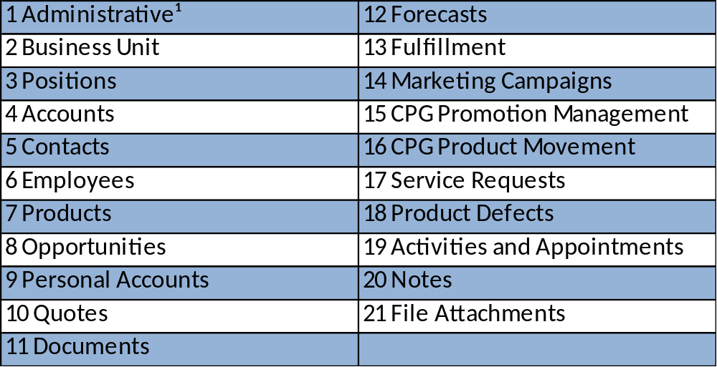
Importing Legacy Data
Entity load order
¹ - An example of administrative data would be a List of Values for Currency or Zip Code.
Disable Transaction logging
Start EIM load per batch and review import success.
Notes:
Invoking Enterprise Integration Manager
COMPANY CONFIDENTIAL AND PROPRIETARY INFORMATION — DUPLICATION IS PROHIBITED
35.<number>

Slide 6
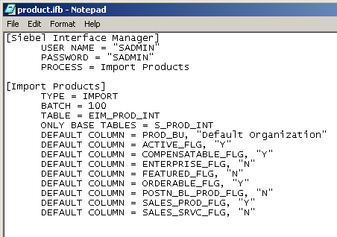
Configuration (.ifb) file: Imports
Direct execution of an EIM task using a configuration (.ifb) file
  Specifies the batch, order, and type of processing
  Uses the default.ifb as a template
Section to process
IF_ROW_BATCH_NUM value - rows to process
Destination table
EIM table
Default column values
Notes:
Invoking Enterprise Integration Manager
COMPANY CONFIDENTIAL AND PROPRIETARY INFORMATION — DUPLICATION IS PROHIBITED
35.<number>
This slide annotates the .ifb file. Point out the easy way to set default values for required columns if you are not using them in your implementation.
Troubleshooting: Some EIM tables do not support the DEFAULT COLUMN parameter. You can also load defaults directly into the EIM table, for example with the SET SQL statement.

Slide 7
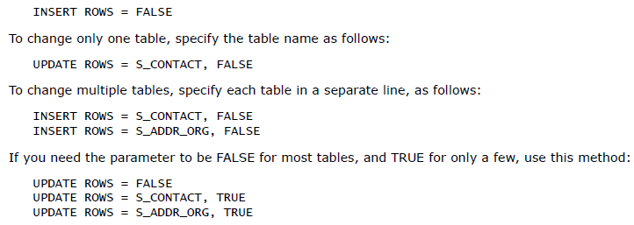
Imports: Inserts & Updates
By default EIM upserts!!
Suppress using:
  INSERT ROWS
  UPDATE ROWS
Examples:
Notes:
Invoking Enterprise Integration Manager
COMPANY CONFIDENTIAL AND PROPRIETARY INFORMATION — DUPLICATION IS PROHIBITED
35.<number>
The point here is do not blindly load data into base tables if unsure which table is being populated. Instead, specify base tables used and whether inserts or updates or both.

Slide 8
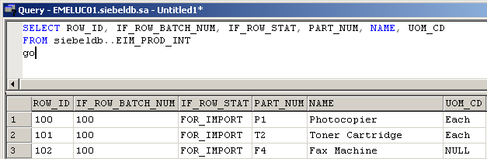
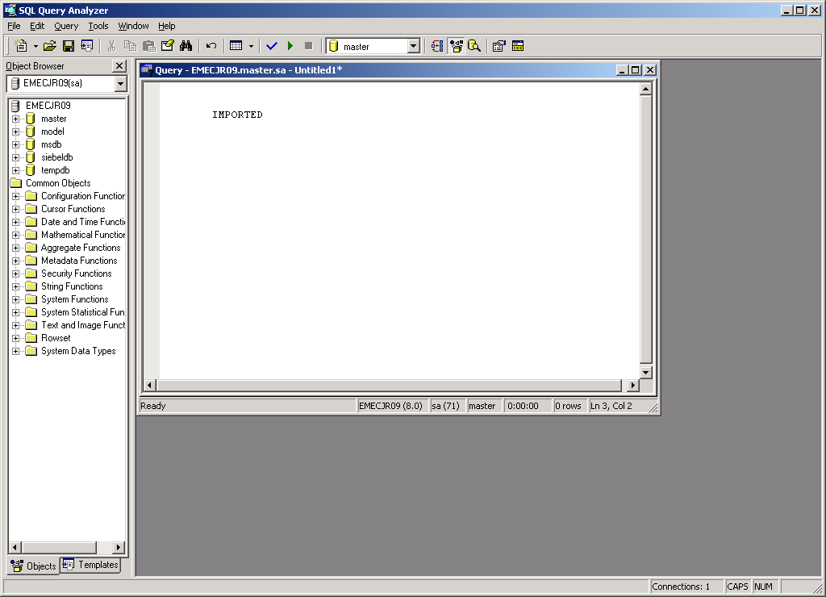

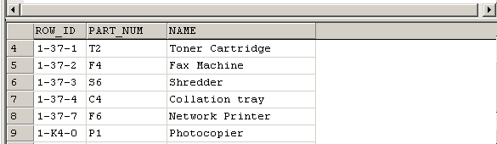
Verify Tables
Run SQL SELECT statements to verify the table data
Notes:
Invoking Enterprise Integration Manager
COMPANY CONFIDENTIAL AND PROPRIETARY INFORMATION — DUPLICATION IS PROHIBITED
35.<number>
Verify the values in the EIM table were properly set in the target base tables. This example is using MS SQL Server syntax in Query Analyzer. One must use a database tool. Siebel Systems does not provide an interactive SQL utility for server databases, although dbisql.exe is provided for SQL Anywhere local databases.

Slide 9
Common IF_ROW_STAT Values for Imports
IMPORTED
  Success for all target/destination tables
PICKLIST_VALUES
  Failed because required picklist value not found in S_LST_OF_VAL
REQUIRED_COLS
  Failed because required column has NULL value
DUP_RECORD_EXISTS
  Failed because target table has row with same values
Notes:
Invoking Enterprise Integration Manager
COMPANY CONFIDENTIAL AND PROPRIETARY INFORMATION — DUPLICATION IS PROHIBITED
35.<number>
This slide highlights common statuses. Refer to the Siebel Enterprise Integration Manager Administration Guide.

Slide 10
Common IF_ROW_STAT Values for Imports (cntd.)
FOREIGN_KEY
  Failed because a required foreign key could not be resolved
PARTIALLY_IMPORTED
  Success for target base table; failure for secondary table
NOT_ALLOWED
  that EIM has attempted to insert a new row, but the action is not allowed
Notes:
Invoking Enterprise Integration Manager
COMPANY CONFIDENTIAL AND PROPRIETARY INFORMATION — DUPLICATION IS PROHIBITED
35.<number>

Slide 11
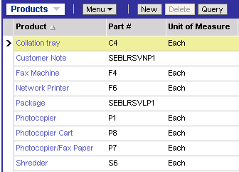
Verify Information in Application
Verify product information is in the application using appropriate views
  Example: Administration - Product
Verify products were imported successfully
Notes:
Invoking Enterprise Integration Manager
COMPANY CONFIDENTIAL AND PROPRIETARY INFORMATION — DUPLICATION IS PROHIBITED
35.<number>
Make sure the data is visible in the appropriate views in the application. Data may not be visible in other views if teams or owners were not imported.

Slide 12
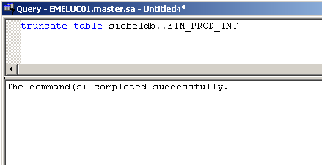
Remove Data from EIM Tables
You are responsible for removing records from the EIM tables
  Use SQL to delete EIM table records once they have been successfully processed
Notes:
Invoking Enterprise Integration Manager
COMPANY CONFIDENTIAL AND PROPRIETARY INFORMATION — DUPLICATION IS PROHIBITED
35.<number>
Clearing out data from the EIM tables is a good programming practice.

Slide 13
Summary
This module showed you how to:
  Understand the process flow for EIM imports
  Create/Modify configuration (.ifb) files for inserts and updates
  Identify Import status through IF_ROW_STAT
Notes:
Invoking Enterprise Integration Manager
COMPANY CONFIDENTIAL AND PROPRIETARY INFORMATION — DUPLICATION IS PROHIBITED
35.<number>
True or false: SQL can be used to insert data into an EIM table without compromising referential integrity.
Review Question: What is the purpose of turning off transaction logging during initial loads?

Slide 14
Lab
In the labs you will:
  Use the Enterprise Manager’s Data Transformation Services facility to load external solution data from a file into the appropriate EIM interface table
  Perform an EIM update based on different types of fields, namely:
    Normal field
    LOV bounded field
    Foreign Key field
Notes:
Invoking Enterprise Integration Manager
COMPANY CONFIDENTIAL AND PROPRIETARY INFORMATION — DUPLICATION IS PROHIBITED
35.<number>
See lab instructions for details.

